Slide 1
Strategies for Updating Your Concussion Management Plan NYSATA Annual Meeting and Clinical Symposia June 24, 2020 Chris Hummel, Clinical Professor/Athletic Trainer Michael Matheny, Clinical Professor/Head Athletic Trainer Department of Exercise Science and Athletic Training Ithaca College

Slide 2
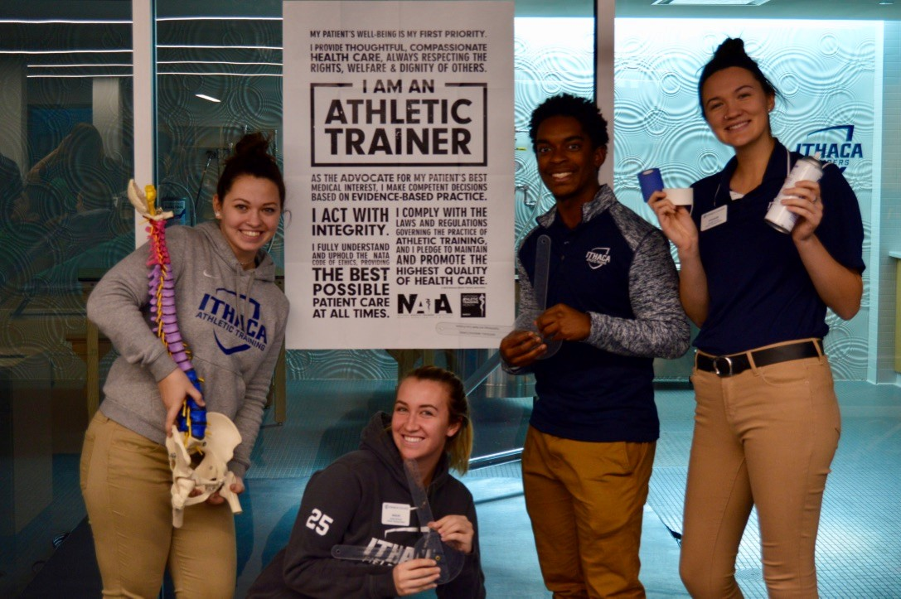
Disclosures
We affirm that we have no financial affiliation or involvement with any commercial organization that has a direct financial interest in any matter included in this presentation

Slide 3
Objectives
Upon completion of this presentation, the participants will be able to:
Understand the need to regularly update/review their concussion management plan
Understand the essential components of a concussion management plan
Understand current guidelines, best practice, and standard of care for concussion management
Evaluate their own plan to identify areas that could be improved or modified to address current evidence based practice

Slide 4
The Ever-Evolving Nature of Concussion Management
We have learned so much about concussions in the last 20 years…
“If you didn’t lose consciousness it’s not that big a deal.”
Cantu Classification System
Three Strikes and You’re Out
Complete and Total Rest for two weeks…
Baseline Testing
Pre-Recovery Exercise, Rehabilitation (Vestibular/Oculomotor)
But there is so much that we still don’t know…

Slide 5
Navigating Multiple Guidelines
5th Consensus Statement (Berlin, 2016)
NATA Position Statement (2014)
NCAA
Arrington Class Action Settlement (2019)
Interassociation Consensus: Diagnosis and Management of Sport-Related Concussion Best Practices (2017)
NCAA Sport Science Institute Concussion Safety Protocol
State, School District
Institution

Slide 6
Best Practice vs. Standard of Care “A Question of Resources”
Standard of Care
A diagnostic and treatment process that a clinician should follow for a certain type of patient, illness or clinical circumstance (NEJM, 2004)
The level at which the average, prudent provider in a given community would practice. How would similar qualified/licensed/certified professionals manage the patient under the same/similar circumstances (MedicineNET)
Best Practice
Harder to define
Evidence Based Practice (Expertise, Patient Values, Research)
Clinical Practice Guidelines, Recommendations
Different Levels=Different Resources

Slide 7
Where do you begin to evaluate or review your current plan?
When was your last review?
Who should be involved in this review?
AT staff, MD, Legal Counsel (if applicable)
Athletic Administrators, Coaches
What is the evidence (aka: guidelines) you will use to make changes?
What worked well and what didn’t work well this past year?
Has your budget/resources changed?

Slide 8
Key Components of a Concussion Management Plan
Education
Baseline Testing
Recognition and Diagnosis
Evaluation and Treatment
Return to Learn
Return to Play
Multidisciplinary Team Approach
Documentation and Reporting

Slide 9
Education
Who are you educating?
Medical Staff (MD, AT Staff, S&C)
Coaches, Administrators
Student-Athletes
Parents
School Board, Public
Will this be face to face or remote/online education/training?
Website
Management Plan
Education, Training Resources
Follow-up, Forum for Questions/Concerns

Slide 10
Education: Key Points
What is a Concussion?
S/S of Concussion
What should you do if you think you have a concussion?
Return to Play Criteria/Plan
Return to Learn Criteria/Plan
Baseline Testing
Directions to more resources

Slide 11
Baseline Testing
Who are you testing?
How and When will the testing take place?
At home vs. on campus (level of supervision?)
What is your baseline testing composed of?
Concussion History
Current Symptom Score
Neurocognitive
Balance
Other
What “fits” your needs and resources?

Slide 12
Neurocognitive Testing
What tool should you use?
What resources (personnel and money) do you have dedicated to NC testing?
ImPACT….
Is this too expensive compared to other NC tests on the market?
SWAY
XLNTBrain
Concussion Vital Signs
BrainCheck

Slide 13
Injury Management
How do you evaluate and formally diagnose a concussion?
Does everyone who comes to you and thinks they have a concussion, indeed have a concussion?
“Culture” of Concussion has greatly changed in the last 10 years
Is there a concussion “epidemic”?
Both knowledge and fear have increased during this time (athletes and parents)
What are the long term outcomes with concussion? CTE?

Slide 14
Initial Treatment
24-48 hours of ‘relative’ rest
Daily recheck, Symptom Scale evaluation
Other testing as needed
When do you conduct post injury NC tests?
1st day post-injury?
When athlete states they feel normal? or
If not feeling normal after 5-7 days…?
Return to Learn, Exercise, & Play

Slide 15
Return to Learn
Evidence supports the need for a graduated return to learn progression
Individual approach but certain universal keys:
Avoid any cognitive activity that increases symptoms
Ongoing communication with faculty/teachers
Encourage participation in those cognitive activities that they can tolerate
Be progressive; gradual increase in cognitive load

Slide 16
Return to Play
Use of graduated return to play protocol is accepted/standard practice
Use of pre-recovery exercise (IC PREP) has been positive addition to our RTP protocol
The evidence is very supportive of beginning light, monitored exercise while still exhibiting symptoms
Clinician directed and individualized but typically begins 48-72 hours after injury

Slide 17
Physician Clearance
What is your plan?
When and how will this get done?
When in the RTP/RTL process is the MD “clearing” the athlete?
How is this documented?
How is this impacted with when dealing with local MD with little to no concussion expertise?
How do you handle non-Team MD clearance?

Slide 18
Multidisciplinary Team
Creation of a “Concussion Care Team” will be quite helpful when managing more complex cases, including those that involve delays in return to learning and participation.
Identify personnel in your “community” that can play a role in this team approach:
Team MD
AT Staff
Counselor or Mental Health professional
Neuropsychologist
Academic Advisor/Guidance counselor
Student Academic Services, Faculty Athletics Rep
Others…

Slide 19
Documentation, Reporting
Do you have standardized documentation for each concussion?
How does this get communicated?
MD
Parents/Guardians
School Nurse, Guidance Counselor
Coach, AD
Do you have to report concussion numbers/rates, etc to anyone?
NCAA
School District
Insurance Provider

Slide 20
Summary
The world of concussion management is constant evolving.
This requires us to continually review and evaluate our concussion management plans.
We need to identify the best evidence available
Adapt current guidelines/recommendations to meet your patient/athlete needs and the resources of your institution/community.

Slide 21
Resources
McCrory P, et al. Consensus statement on concussion in sport – the 5th international conference on concussion in sport held in Berlin, October 2016.
Diagnosis and Management of Sport-Related Concussion, Best Practices. NCAA Sport Science Institute (2017)
If you would like a copy of our updated 2020 Concussion Management Plan, please email matheny@ithaca.edu

Slide 22
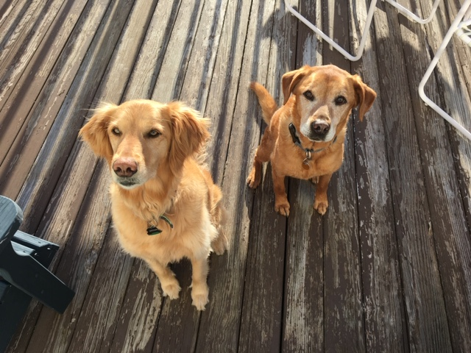
Thank you! Questions?

